Slide 1
PORTFOLIO PROJECT • E-COMMERCE ANALYSIS
Beyond the Dashboard
RFM Segmentation Tool With Excel
Champions
Loyal
Potential
At Risk
Customer Segmentation · Revenue Concentration · Growth Signals

Slide 2
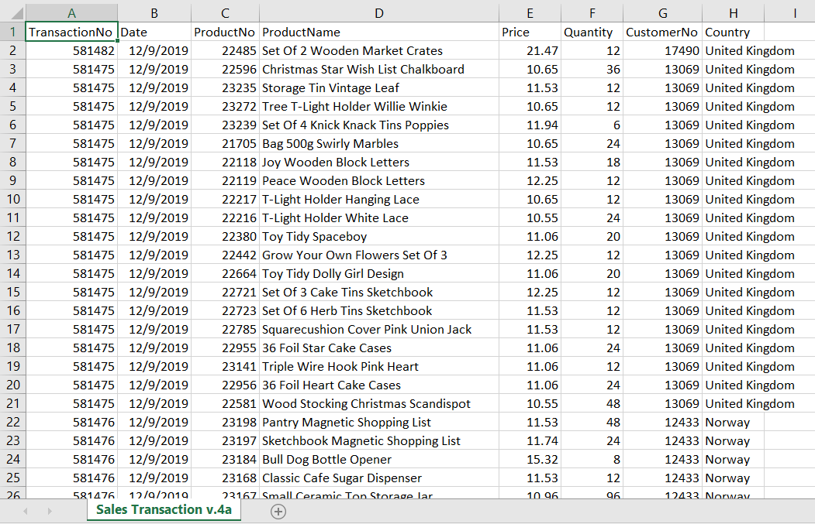
WHERE IT ALL COMES FROM
The Source Dataset
Every model, chart, and insight in this deck (RFM segmentation, product, price, geography, and trend analysis) is built entirely from one raw transaction data file. A total of 531,147 Rows x 8 Cols. were analyzed.
TransactionNo & Date — order-level identifiers
ProductNo & ProductName — item sold
Price & Quantity — line-level revenue inputs
CustomerNo & Country — who bought, and from where
Original dataset on Kaggle
Raw transaction log — Sales Transaction sheet (v.4a)
An Online Shop Business — Gabriel Ramos
kaggle.com/datasets/gabrielramos87/an-online-shop-business
Download Excel Project File: GitHub Link
02

Slide 3
THE HEADLINES
Executive Summary
£62.3M
4,738
95% / 85%
Total revenue generated across the full transaction history.
Unique customers, with a 98% repeat-purchase rate.
Share of customers / revenue coming from the UK alone.
389 → 42%
£699K
35%
Champions are 8% of customers but drive 42% of revenue.
Revenue sitting with 34 high-value At-Risk customers.
Share of the year’s revenue happens in Q4 alone.
03

Slide 4
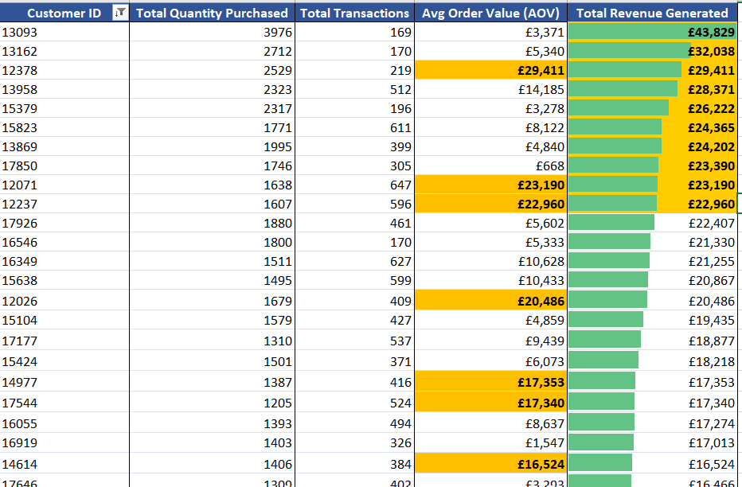
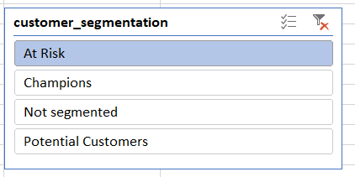
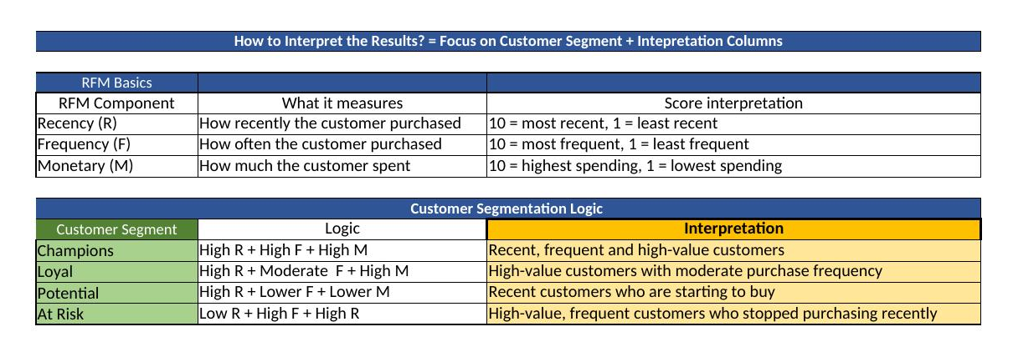
THE TOOL BEHIND THE INSIGHTS
Download Excel Project File: GitHub Link
Meet the Segmentation Tool
Every customer is scored 0–10 on three axes: how recently they bought, how often, and how much they spent, using percentile ranks. The shown pivot runs on a data model and using the slicer you can find customers by their respective segments.
Champions
High Recency + High Frequency + High Monetary — recent, frequent, high-value.
Loyal
High Frequency + High Monetary — steady, moderate-recency value.
Potential
High Recency, lower Frequency/Monetary — new buyers who haven’t spent much
At Risk
Low Recency + High Frequency + High Monetary — big spenders gone quiet.
Straight from the workbook: the live segmentation tool screenshot.
04

Slide 5
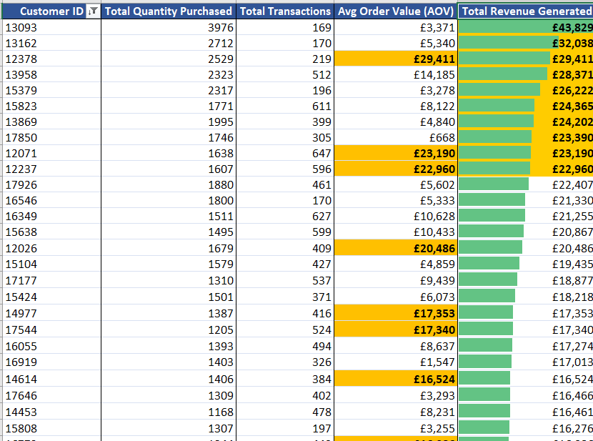
SEGMENT IN ACTION: AT RISK
Use Case: Finding Revenue at Risk
Using the slicer, you will see a list of customers at risk. These are customers that used to spend a lot but have now gone quiet. The results are sorted by the total revenue column and top ten values are highlighted. This data can be used by marketing and retention teams.
34
at-risk customers identified
£699K
combined revenue exposure
£20.6K
avg. value per customer — 57% above the typical customer
~230 days
average time since their last order
These are historically high-frequency, high-spend customers who've gone quiet: a ready-made target list for a win-back campaign.
05

Slide 6
REVENUE CONCENTRATION
Small Segments, Outsized Impact
Why it matters
Champions are just 8% of customers but 42% of revenue: value them first.
Not Segmented are left out customers which can be segmented further using RFM, as per need.
Potential & At Risk are small in number, but the clearest growth and retention levers on the board.
06

Slide 7
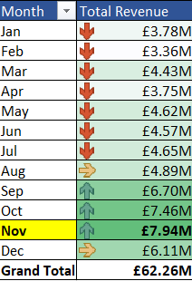
SEASONALITY
The Quarter 4 Surge
Q4 alone brings in £21.5M (35% of annual revenue) and 8,262 transactions (36% of annual volume): November is the single biggest month at £7.94M. This can help prepare for future surges in Q4.
07

Slide 8
PRODUCT PERFORMANCE
What's Actually Selling
Popcorn Holder tops both charts: highest revenue (£591K) and highest volume (57K units). But the top 10 products combined are only 6.5% of total revenue: this is a long-tail catalog, not a hits-driven one.
08

Slide 9
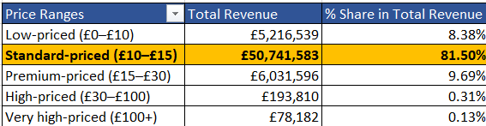
PRICING STRATEGY
The £10–£15 Sweet Spot
81%
of total revenue (£50.7M) comes from the Standard-priced band — £10 to £15. Median product price sits at £11.94.
Pricing outside the £10–£15 band barely moves revenue: a strong signal for where future SKUs should be priced.
09

Slide 10
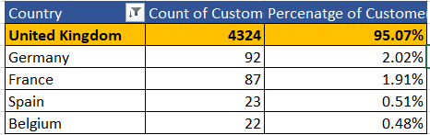
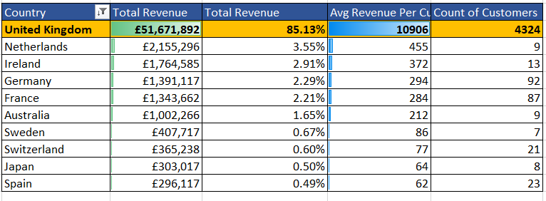
GEOGRAPHY
A UK Business, Mostly
95%
of customers and 85% of revenue (£51.7M) comes from the United Kingdom.
Netherlands has the highest avg. revenue per customer outside the UK (£455): a small but efficient market worth a closer look.
10

Slide 11

RETENTION
A Remarkably Sticky Customer Base
98%
REPEAT-PURCHASE RATE
Only 102 of 4,738 customers (2%) are one-time buyers. Once someone converts, they almost always come back and retention is clearly this business's strength.
The flip side: with so few first-time buyers, top-of-funnel acquisition looks thin which raises a natural next question for this dataset.
11

Slide 12
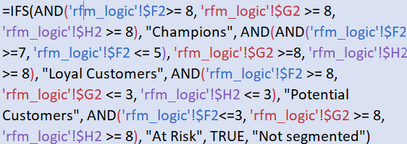
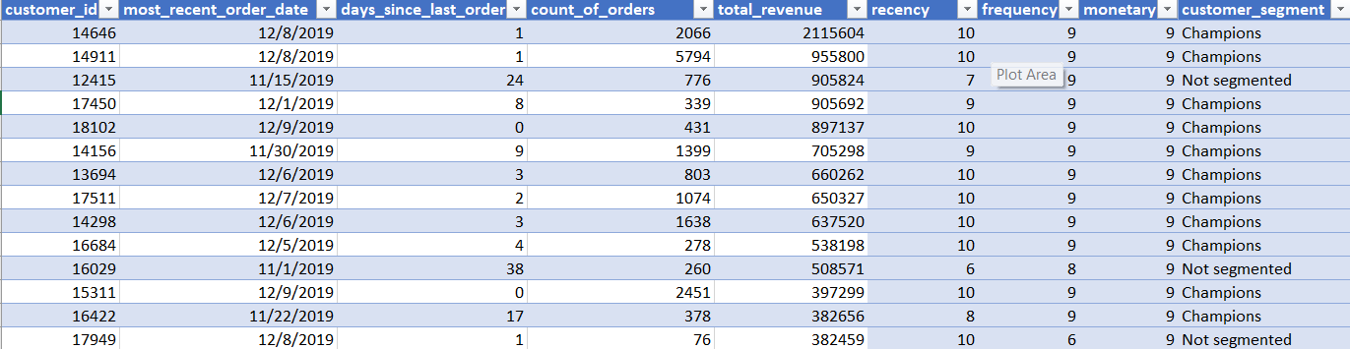
HOW THE SEGMENTS ARE BUILT
Behind the Scenes: RFM Logic (IFS)
1. Score Recency, Frequency and Monetary are each converted to a 0–10 score using PERCENTRANK.EXC against the full customer base.
2. Classify A nested IFS() formula reads the three scores in order and assigns the first matching segment which are Champions, Loyal, Potential, or At Risk.
3. Fall through Anyone who doesn't clear a segment's thresholds is labeled Not Segmented as the long tail seen on slide 6.
12

Slide 13
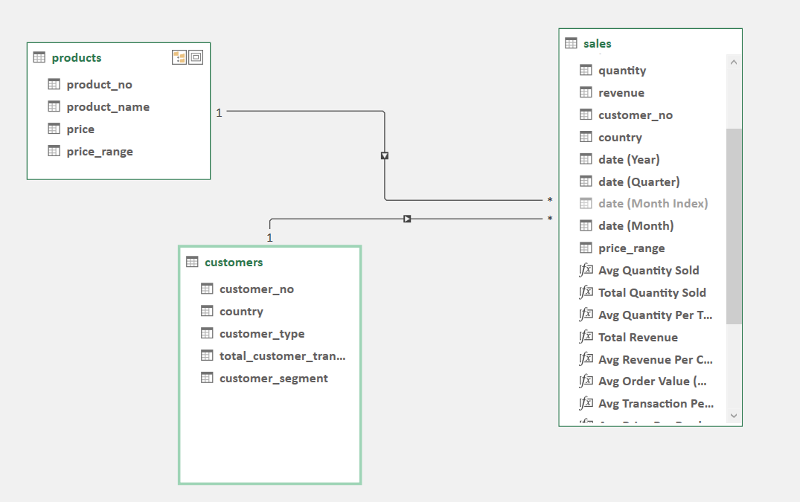
HOW THE SHEETS CONNECT
Behind the Scenes: Data Model
Raw sales, customers and products tables are linked by customer and product IDs, then rolled up into the analysis sheets behind every slide in this deck that calculates segmentation, product, price, country and trend. Using Power Pivot, the model and customized measures like AOV, Average Quantity Sold, etc. are also created.
[ Insert data model screenshot here ]
13

Slide 14
Thank You
Questions? Let's talk about what the data found and what to do next.
Champions
Loyal
Potential
At Risk

